Slide 1
Academic and Behavior Combined (ABC) Support
Self-Guided Training Session 1
Principal Investigator Maribeth Gettinger
Co-Principal Investigator Thomas Kratochwill
Project Manager Alison Staples Lindner
Graduate Research Assistants Abigail Eubanks & Allison Foy
This self-guided training focuses on implementing ABC Support with individual students. The ABC Support Manual includes procedures for implementation with individual students or small groups. Although implementation varies slightly between individual and small-group formats, the intervention components are the same. Teachers should be able to successfully implement ABC Support with small groups of students following training and practice with a one-on-one format.

Slide 2
Session #1 Objectives
“Walk-through” ABC Support Manual and Intervention M Materials Handbook
Significance and rationale for ABC Support
Evidence-based intervention elements
Implementation Self-Guide (21 intervention steps)
DESCRIBE – DEMONSTRATE – PRACTICE intervention steps

Slide 3
Objective 1: ABC Support Manual and Intervention Materials Handbook
ABC Support Manual
Part I: Conceptual Foundation and Research Support
Part II: Implementation Procedures
Section II-2: Description and Sequence of Intervention Steps
Part III: Appendices
Intervention Materials Handbook

Slide 4
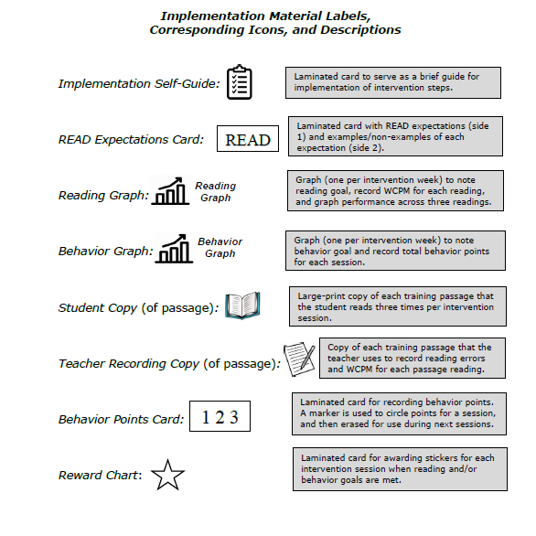
Link each tool with specific step …

Slide 5
Objective 2: Significance and Rationale for ABC Support
What is integrated supplemental support?
Instead of separate “single-focus” interventions …
Retain effective strategies of single-focus interventions (reading and behavior) and merge shared components
Why is there a need for ABC Support?
Behavior-academic link:
Reading performance ↔ Inattentive, disruptive behavior
Behavior + academic issues co-occur 50-80% of the time
Surfaces as early as kindergarten
At risk for long-term negative outcomes

Slide 6
Objective 3: Intervention Elements
Expectations
Goal-setting
Modeling
Repeated practice
Prompts
Feedback, Recording and Praise
Reading error correction and behavior redirection
Recording and graphing
Rewards
Self-monitoring
High level of structure
Appropriate match to level
Manual Section I-2: Table of elements and research support
Manual Section II-3: Detailed procedures for elements in red

Slide 7
Objective 4: Implementation Self-Guide
Manual Section II-2: Description and sequence of intervention steps

Slide 8
Objective 5: DESCRIBE-DEMONSTRATE-PRACTICE Intervention Steps

Slide 9
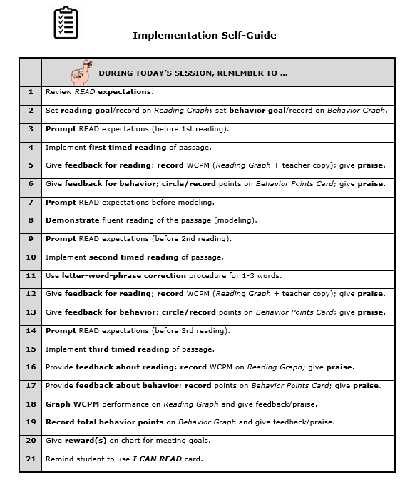
Step 1: EXPECTATIONS
Notes:
Step 1 is the review the READ expectations!

Slide 10
EXPECTATIONS
DESCRIBE
What? Display and teach/review four expectations for reading and behavior.
When? Teach expectations during orientation session; review at the beginning of each intervention session (Step #1) – and throughout the session, as needed.
How? READ Expectations Card

Slide 11
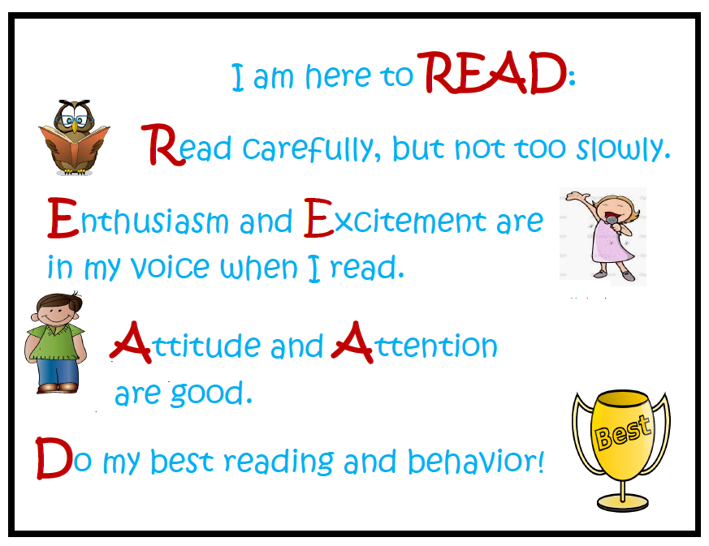
DEMONSTRATE
Notes:
Demonstrate

Slide 12
PRACTICE
Notes:
Goal Setting: “Final Video” Xm Xs

Slide 13
Step 2: READING AND BEHAVIOR GOALS

Slide 14
GOAL-SETTING
DESCRIBE
What? Determine and record one reading goal and one behavior goal for each intervention session.
When? Determine goals before each intervention session; state and record goals during Step #2 of intervention session.
How? See “Goal-Setting Guidelines” in manual. Use Reading Graph and Behavior Graph to record session goals.

Slide 15
Guidelines:
Attainable, but slightly higher than previous goal
Adjusted, if necessary, based on student’s performance
Behavior Goal:
Week 1: Select goal in lowest range (12-19 points)
Weeks 2-8*: Increase weekly by at least 2-3 points
Reading Goal:
Week 1: 20-25 WCPM higher than average on orientation passages
Weeks 2-8*: Increase by at least 1 word from previous session
Two consecutive sessions without meeting goal: Adjust 5-10 words lower
* ABC Support may be implemented for 6-8 weeks.

Slide 16
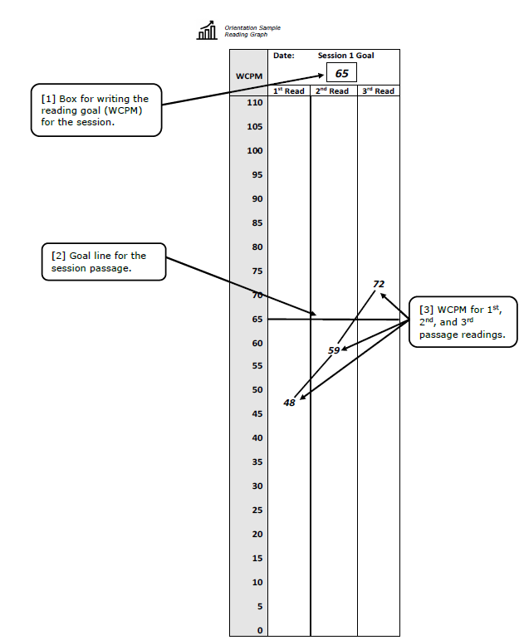
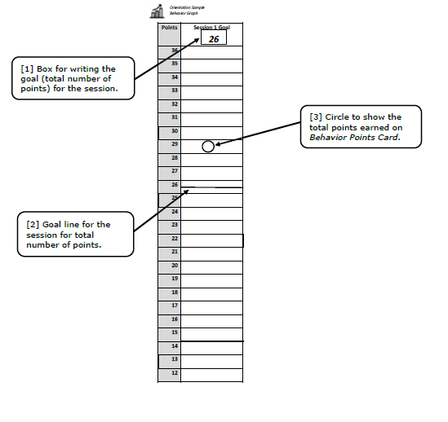
DEMONSTRATE

Slide 17
PRACTICE

Slide 18
Step 3: PROMPT EXPECTATIONS
Step 7: PROMPT EXPECTATIONS
Step 9: PROMPT EXPECTATIONS
Step 14: PROMPT EXPECTATIONS

Slide 19
PROMPTING
DESCRIBE
What? Verbal cues or reminders for students about READ expectations.
When? Four times during every intervention session – prior to each passage reading (Steps #3, #9, #14) and prior to modeling (Step #7)
How? Scripted prompts on Teacher Recording Copy of each passage; scripted prompts included in manual

Slide 20
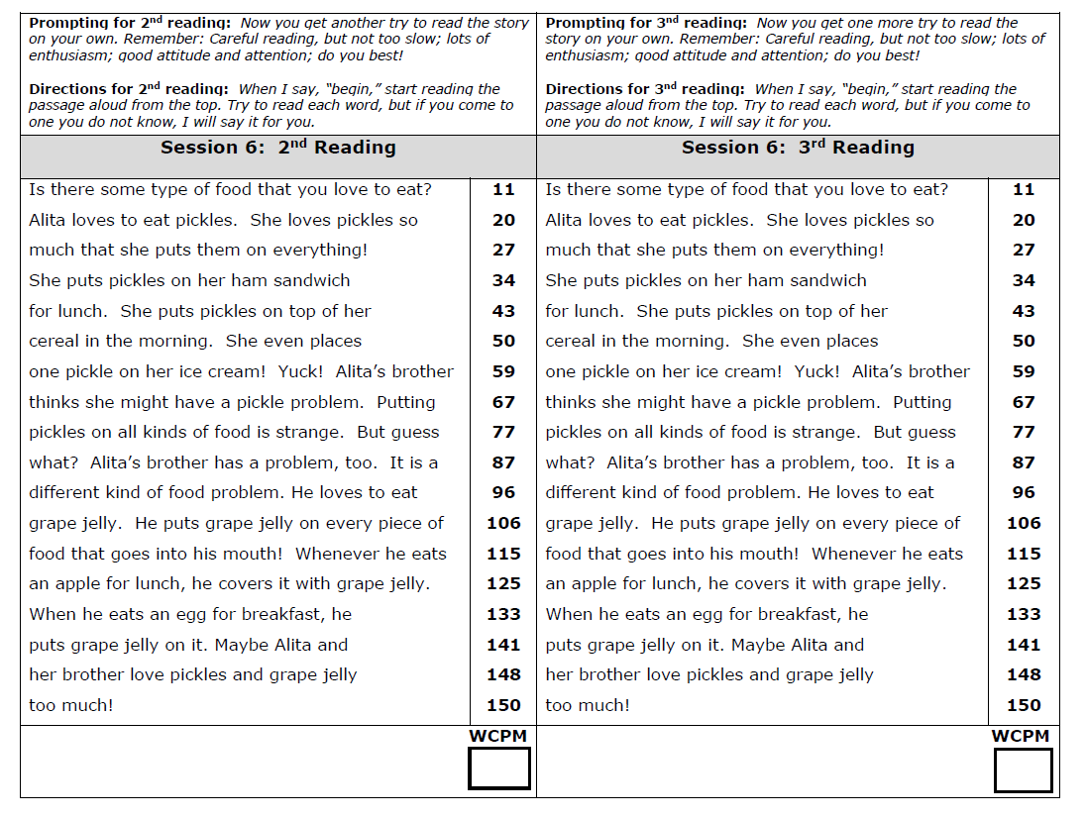
DEMONSTRATE
Notes:
Coach demonstrates

Slide 21
PRACTICE

Slide 22
Step 4: PASSAGE READING
Step 10: PASSAGE READING
Step 15: PASSAGE READING

Slide 23
PASSAGE READING
DESCRIBE
What? Repeated reading of training passage to practice fluent reading and rehearse engagement behaviors
When? Three repeated readings during each session (Steps #4, #10, #15)
How? Student reads for one minute from Student Copy while teacher records errors (to calculate WCPM) on Teacher Copy. See “Scoring and Recording Words Correct Per Minute” in manual.

Slide 24
Record Errors on Teacher Copy:
Draw SLASH through each error
Draw VERTICAL LINE after the last word read at one minute
Score (SLASH) the Following Errors:
Misread word
Omitted or skipped whole word
Added or omitted word part
≥ 3-second pause/hesitation [SLASH it and SAY WORD for student]
Calculate WCPM:
Subtract number of ERRORS from TOTAL NUMBER of words read in one minute

Slide 25
Error Recording and Calculating WCPM
There is a large maple tree outside my bedroom window. A mother robin built her nest in the tree. She laid three eggs. I could see the nest from my window. Soon the small blue eggs hatched. There were three little birds sitting in the nest! The baby birds were hungry. They chirped for their mother to feed them. I knew the mother would get no rest until she fed her babies. I watched her leave the nest to go search for dinner. She flew all around looking for a worm. Soon she saw one sliding through the grass near a bush. She quickly flew down to snatch it up in her beak. Then she went back to the nest. The second she returned, the baby birds opened their mouths wide. They were ready to be fed their meal. Their mother can take a nap at last! | 6 10 17 23 30 38 48 56 66 76 86 95 104 115 124 132 142 147
WCPM
DEMONSTRATE
33

Slide 26
DEMONSTRATE
56
Notes:
Coach demonstrates

Slide 27
PRACTICE

Slide 28
Steps 5 & 6: FEEDBACK, RECORD, PRAISE
Steps 12 & 13: FEEDBACK, RECORD, PRAISE
Steps 16 & 17: FEEDBACK, RECORD, PRAISE
Notes:
The next step we will discuss is feedback, record, and praise. This will happen three times.

Slide 29
FEEDBACK, RECORD, PRAISE
DESCRIBE
What? Provide feedback and record performance for reading (WCPM) and behavior (behavior points). Give praise relative to READ Expectations.
When? Following each passage reading
How? Use Reading Graph to give feedback and record WCPM. Use Behavior Points Card to give feedback and record behavior points. See “Appendix C: Effective Praise” for guidelines in delivering praise.

Slide 30
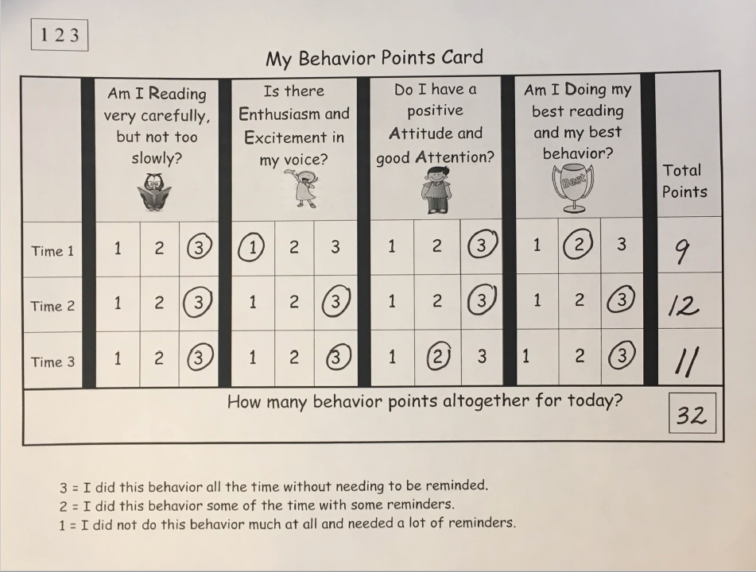
DEMONSTRATE
Recording Behavior
Recording
Reading

Slide 31
PRACTICE

Slide 32
End of Part 1!

Slide 33
Academic and Behavior Combined (ABC) Support
Self-Guided Training Session 2
Principal Investigator Maribeth Gettinger
Co-Principal Investigator Thomas Kratochwill
Project Manager Alison Lindner Staples
Graduate Research Assistants Abigail Eubanks & Allison Foy
Notes:
Welcome to training part 2!

Slide 34
Session #2 Objectives
DESCRIBE – DEMONSTRATE – PRACTICE intervention steps
Review Orientation Sessions
3. Preview on-site coaching process

Slide 35
Objective 1: DESCRIBE-DEMONSTRATE-PRACTICE Intervention Steps

Slide 36
Step 8: Modeling
Notes:
Intervention step 8 is modeling.

Slide 37
MODELING
DESCRIBE
What? Demonstration of fluent reading and engaged behavior while reading aloud
When? After the student’s first reading of the passage
How? Read 1/3 of the passage aloud. At three different points in the remainder of passage, stop reading in the middle of a sentence/line. The student reads to end of the sentence/line.

Slide 38
DEMONSTRATE
Error Recording and Calculating WCPM
There is a large maple tree outside my bedroom window. A mother robin built her nest in the tree. She laid three eggs. I could see the nest from my window. Soon the small blue eggs hatched. There were three little birds sitting in the nest! The baby birds were hungry. They chirped for their mother to feed them. I knew the mother would get no rest until she fed her babies. I watched her leave the nest to go search for dinner. She flew all around looking for a worm. Soon she saw one sliding through the grass near a bush. She quickly flew down to snatch it up in her beak. Then she went back to the nest. The second she returned, the baby birds opened their mouths wide. They were ready to be fed their meal. Their mother can take a nap at last! | 6 10 17 23 30 38 48 56 66 76 86 95 104 115 124 132 142 147
WCPM

Slide 39
PRACTICE

Slide 40
Step 11: ERROR CORRECTION
Notes:
Step 11 is error correction.

Slide 41
ERROR CORRECTION
DESCRIBE
What? Systematic correction of 1-3 missed or difficult words through correction of letters in words, whole words, and/or phrases containing words.
When? Once during each intervention session, immediately following the second passage reading.
How? See “Reading Error Correction Procedure” in manual.

Slide 42
Letter Correction: Point to missed/difficult word (on Student Copy), then to one part of the word that was missed/difficult (beginning, middle, or end). Say the letter names and letter sounds.
Word Correction: Read the word while moving your finger under the word; student reads the word twice. [Begin with word correction if letter correction is not necessary.]
Phrase Correction: Read a meaningful phrase from the passage containing the word (3-6 words) while moving your finger under each word; student reads the phrase twice while moving finger under each word. [Begin with phrase correction only if letter correction and word correction are not necessary.]

Slide 43
DEMONSTRATE
Error Recording and Calculating WCPM
There is a large maple tree outside my bedroom window. A mother robin built her nest in the tree. She laid three eggs. I could see the nest from my window. Soon the small blue eggs hatched. There were three little birds sitting in the nest! The baby birds were hungry. They chirped for their mother to feed them. I knew the mother would get no rest until she fed her babies. I watched her leave the nest to go search for dinner. She flew all around looking for a worm. Soon she saw one sliding through the grass near a bush. She quickly flew down to snatch it up in her beak. Then she went back to the nest. The second she returned, the baby birds opened their mouths wide. They were ready to be fed their meal. Their mother can take a nap at last! | 6 10 17 23 30 38 48 56 66 76 86 95 104 115 124 132 142 147
WCPM

Slide 44
PRACTICE
Notes:
”

Slide 45
Step 18: GRAPHING (READING)
Step 19: GRAPHING (BEHAVIOR)
Notes:
Steps 18 and 19 are graphing.

Slide 46
GRAPHING
DESCRIBE
What? Behavior points and WCPM are graphed and visually compared to behavior/reading goals.
When? After the final (3rd) passage reading
How?
Behavior Graph: Graph (make a circle) total points from Behavior Points Card.
Reading Graph: Graph (draw lines to connect) WCPM across three passage readings.

Slide 47
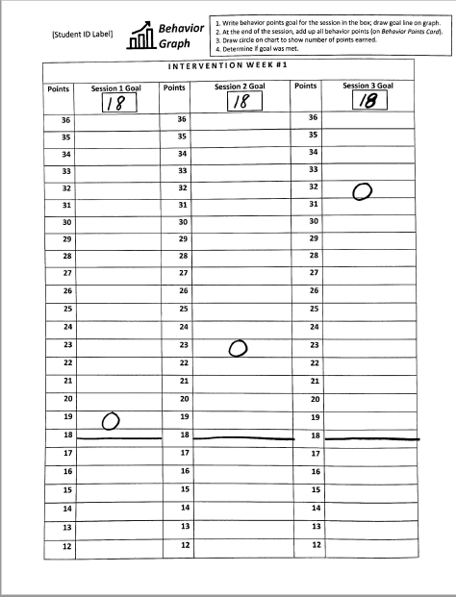
DEMONSTRATE
Behavior Points Card and Behavior Graph

Slide 48
Reading Graph

Slide 49
PRACTICE
Notes:
Pause and take a moment to practice graphing.

Slide 50
Step 20: Rewards
Notes:
The next step is rewards!

Slide 51
REWARDS
DESCRIBE
What? Reward students for reaching reading and/or behavior goals.
When? At the end of each intervention session.
How? Students receive sticker(s) on Reward Chart.

Slide 52
DEMONSTRATE

Slide 53
PRACTICE
Notes:
Take a moment to practice providing rewards.

Slide 54
Step 21: SELF-MONITORING

Slide 55
SELF-MONITORING
DESCRIBE
What? Students self-monitor performance relative to READ expectations during classroom instruction.
When? During all regular classroom activities that involve reading.
How?
1. Post I CAN READ card on student desk
2. Prompt student during reading instruction
3. Give student feedback during reading.

Slide 56
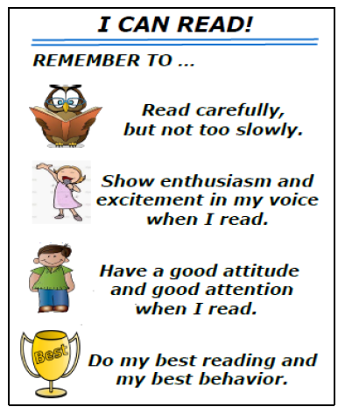
DEMONSTRATE

Slide 57
PRACTICE

Slide 58
Objective #2: Review Orientation Sessions
Two 20-minute sessions prior to 8-week intervention period
Conducted over 2 consecutive days
Purpose: Provide students with explanations, demonstrations, and opportunities to practice intervention components
Orientation Session materials in Implementation Materials Handbook

Slide 59
Objective #3: Preview On-site Coaching Process
On-site coaching of first two interventions sessions
Observe
Correct errors and give feedback

Slide 60
THANK YOU!
Notes:
Thank you so much for participating in the ABC Support training. We sincerely hope this intervention is successful in providing support to your students.

